Slide 1
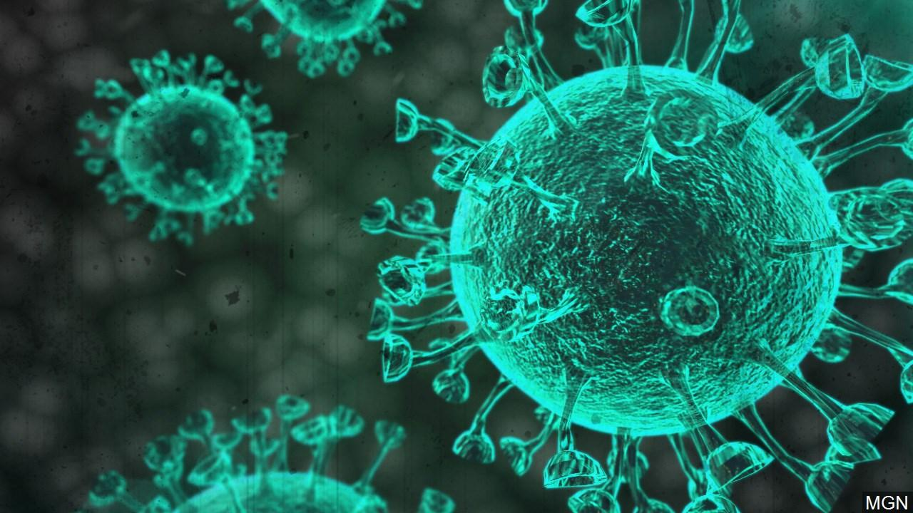
“Covid-19 detection based on symptom data and lungs image ” CSE 489, Sec- A, Group- 05
Group Members
1. Md. Monabbar Hossain ID: 011 152 026
2. Abdur Rahman ID: 011 171 306
4. Tarik Ahmed ID: 011 171 296
5. Md.Nahian Pathan ID: 011 171 265
6. Fahad Hasan Bhuiyan Emon ID: 011 171 150
Course Teacher:
Chowdhury Rafeed Rahman
Lecturer, Department of CSE
United International University

Slide 2
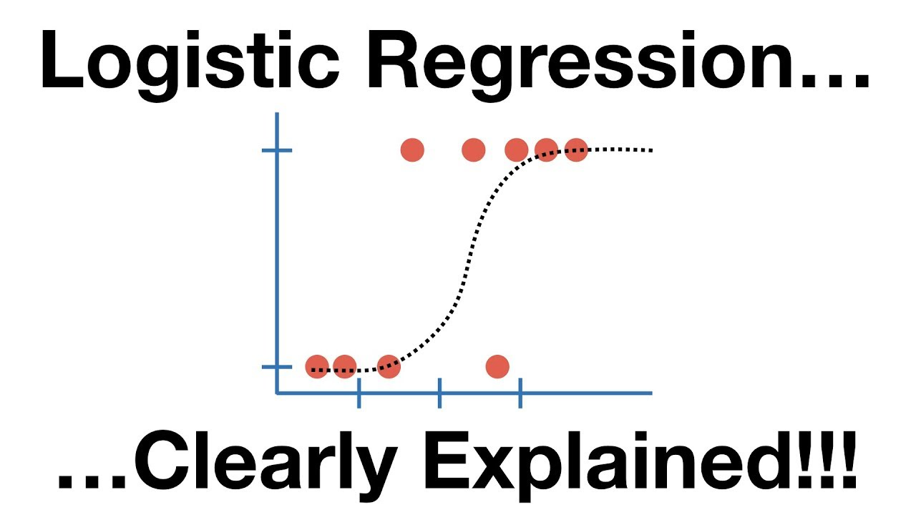
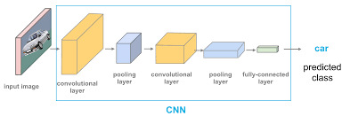
Use Algorithm

Slide 3
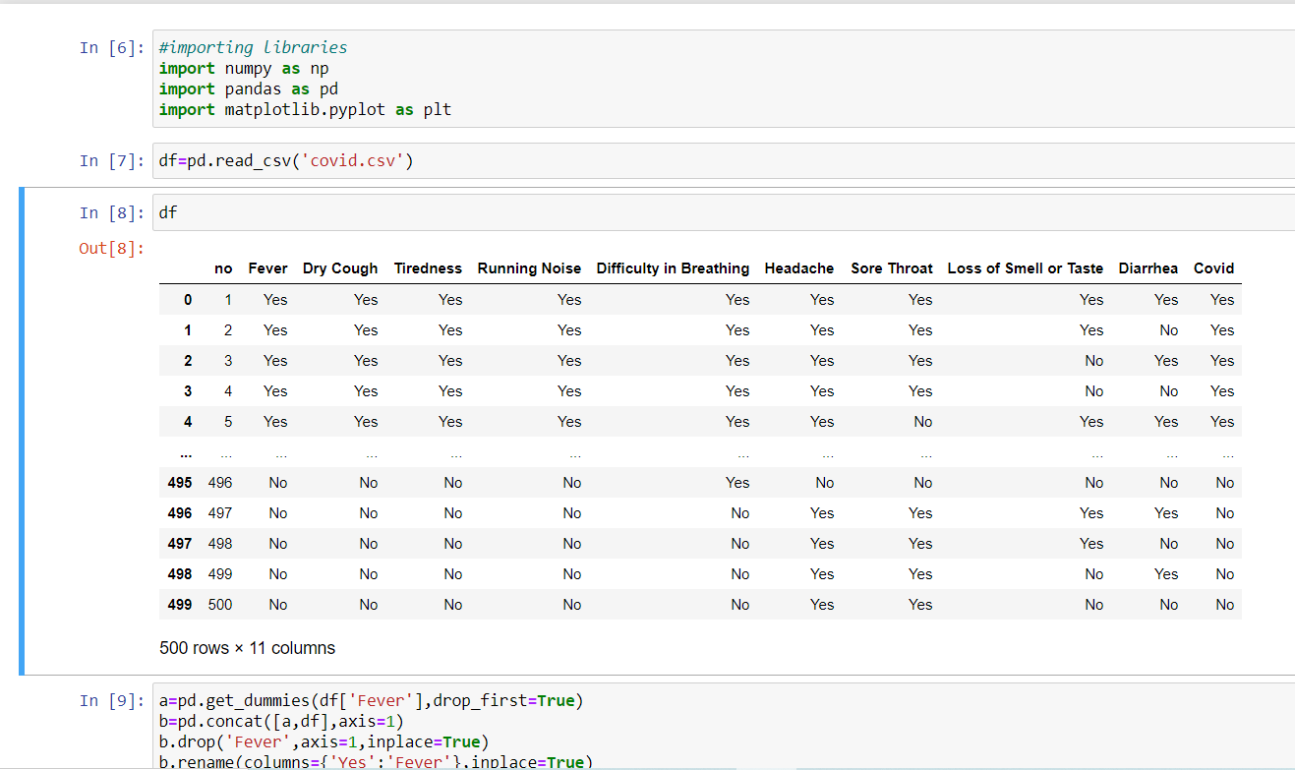
Imported libraries and data-set into jupyter notebook

Slide 4
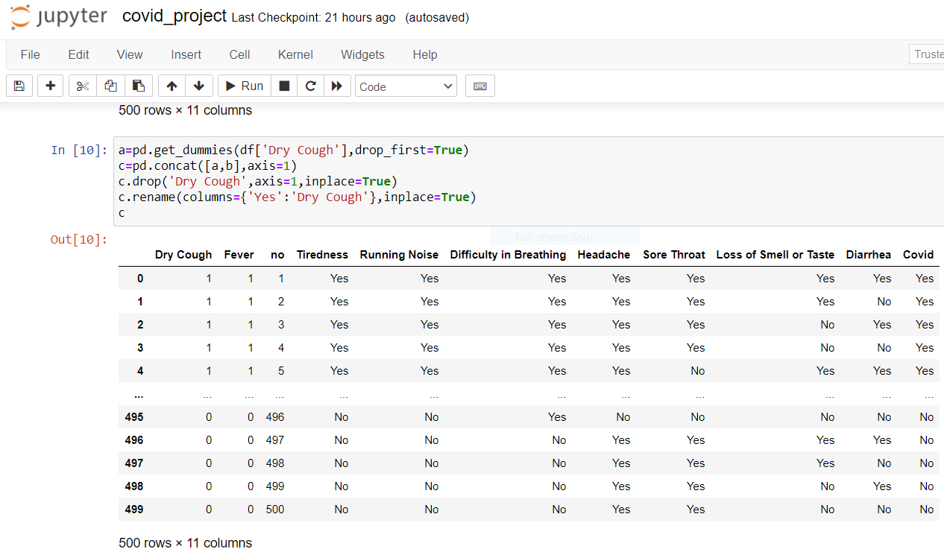
Change categorical data into Binary data

Slide 5
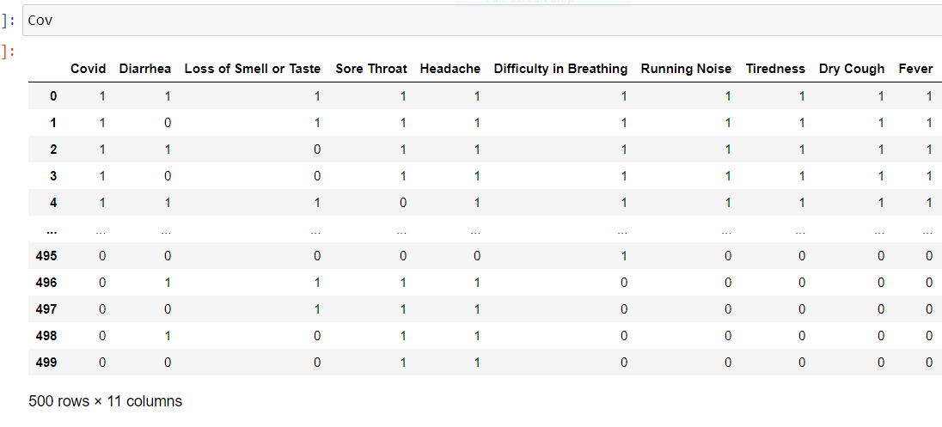
Finished converting data-set to Binary values

Slide 6
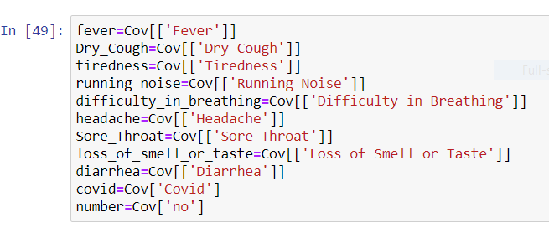
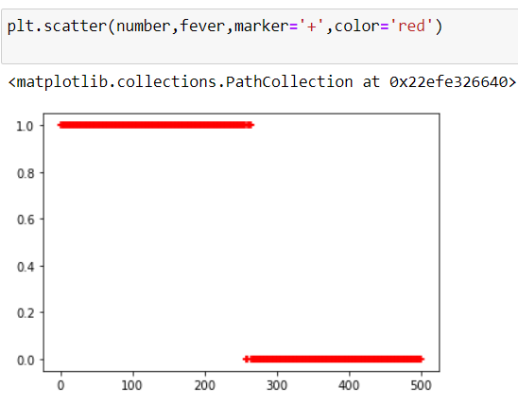
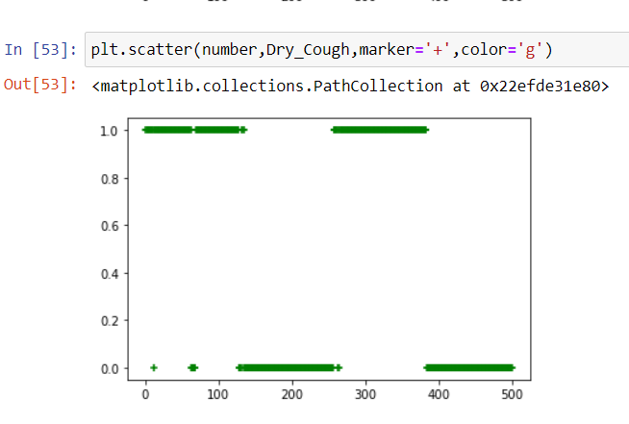
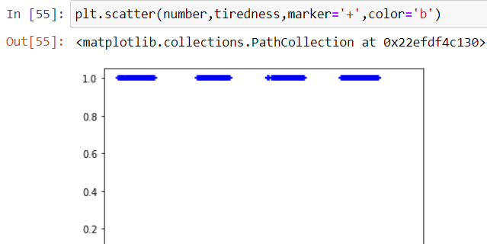
Here we splitted the columns
Then Visualized the data using matplotlib
Fever
Dry Cough
Tiredness

Slide 7
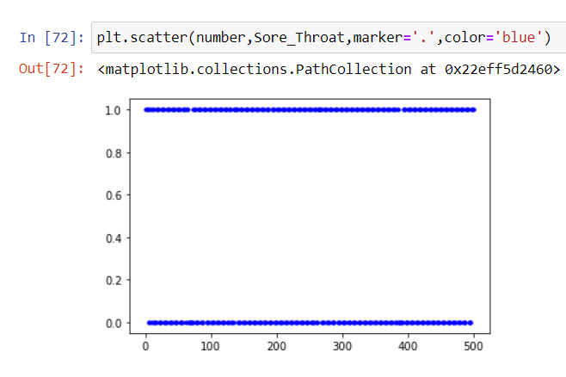
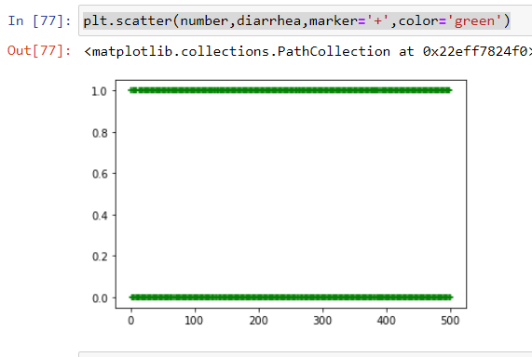
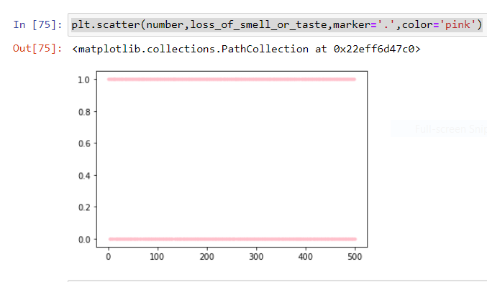
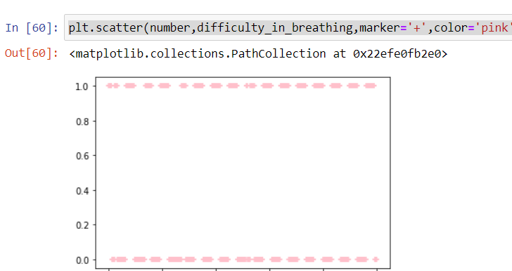
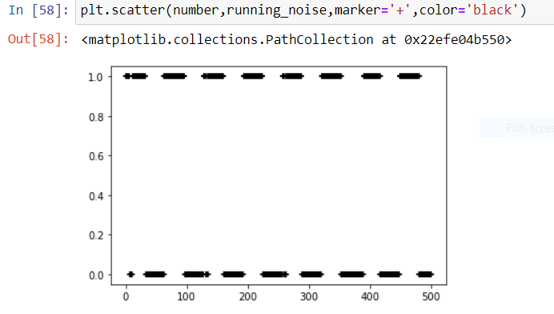
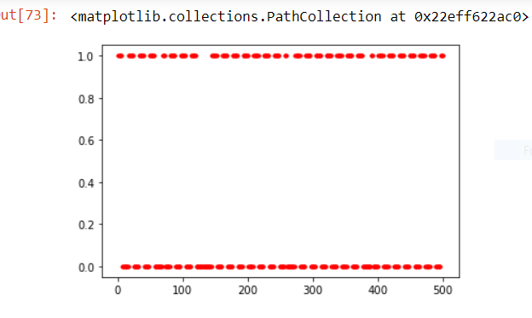
More visualization of data
diarrhea
Loss of smell or taste
Sore Throat
Difficulty in breathing
Running noise
Headache

Slide 8
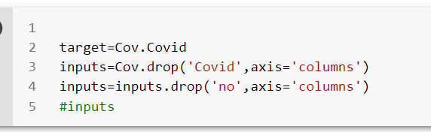
Main Algorithm
input and target data

Slide 9
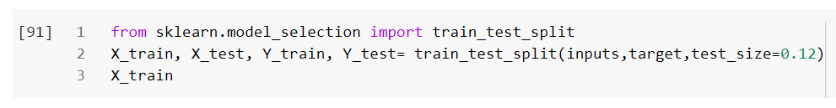
Split data into train and test

Slide 10
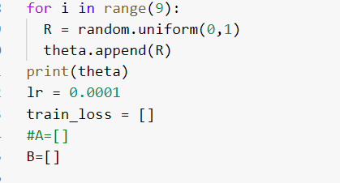

Initialize theta with random variables
‘Dot’ multiply theta and X_train

Slide 11
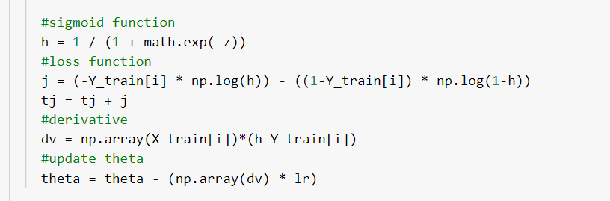
Sigmoid,loss function,derivative and update theta

Slide 12
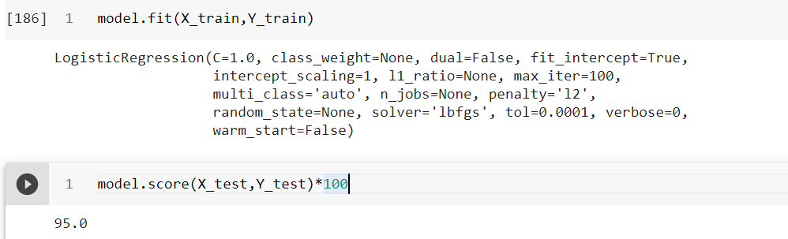
Trained the model and accuracy

Slide 13
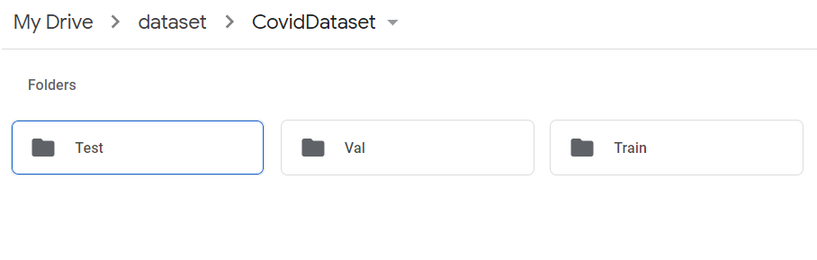
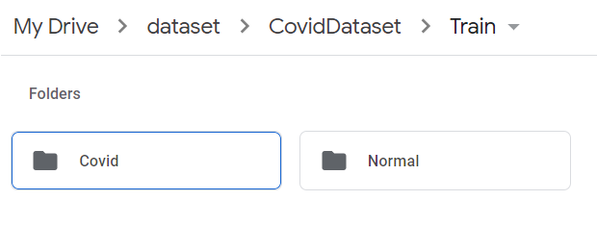
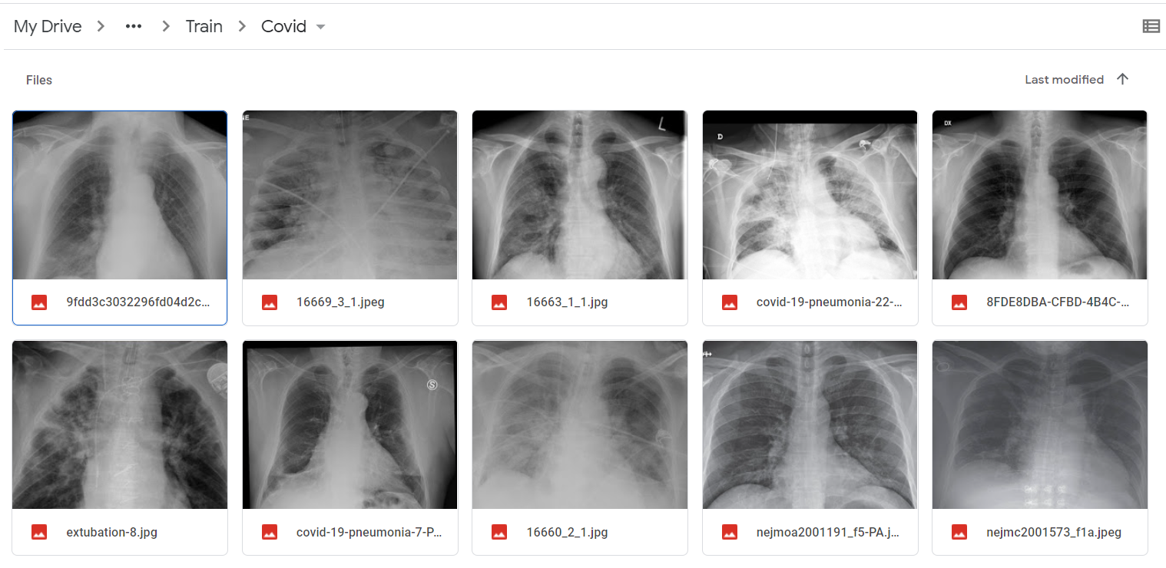
Dataset

Slide 14
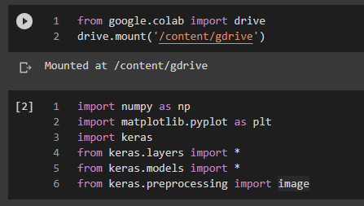
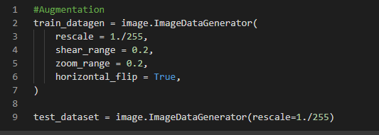
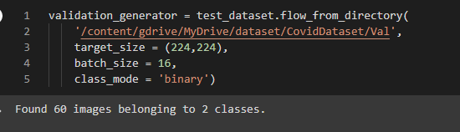
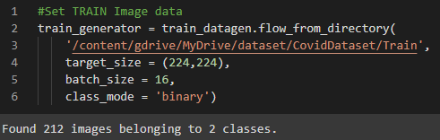
Import & Data Preprocessing
Importing libraries
Image Augmentation
Setting up validation dataset path
Setting up Train dataset path

Slide 15
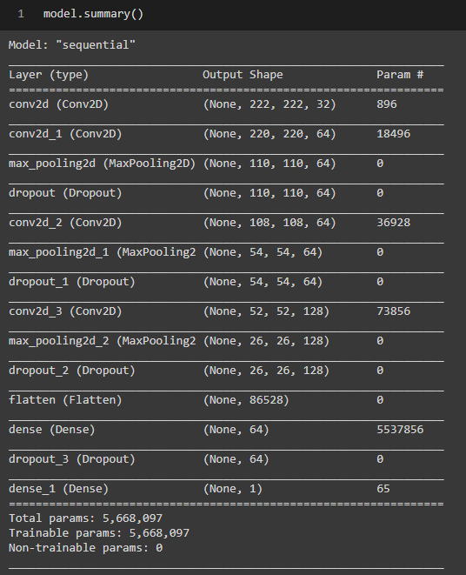
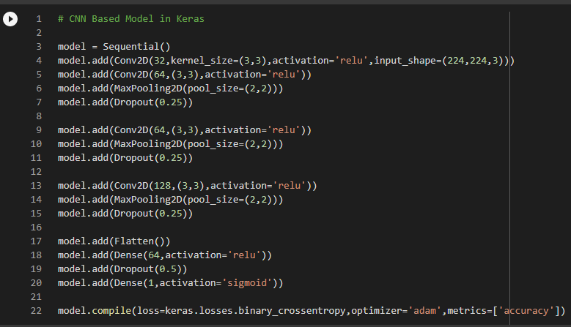
Proposed Algorithm

Slide 16
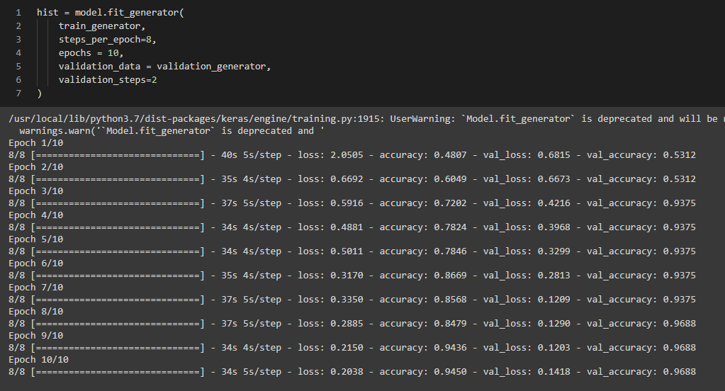
Training model from Scratch

Slide 17
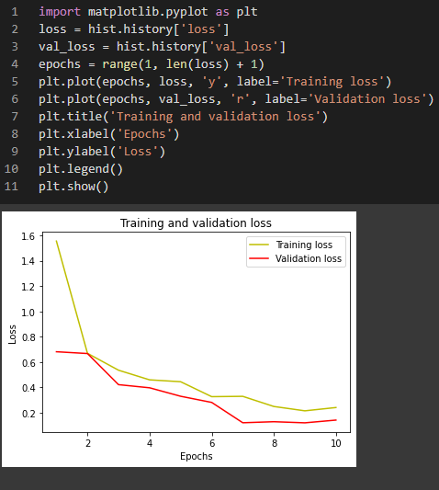
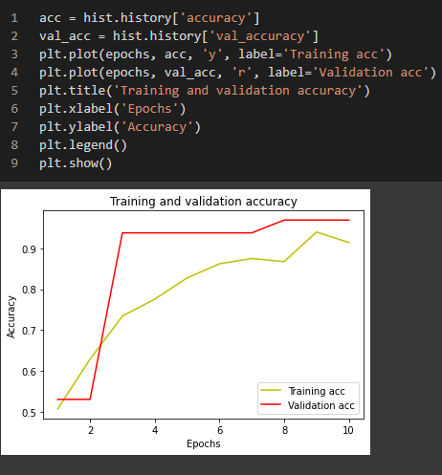
Visualization of Training Data
Loss graph
Accuracy graph

Slide 18
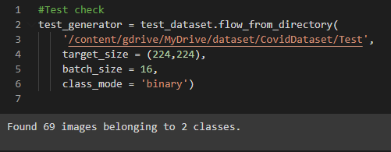



Model Evaluation
Evaluating model
Setting up Test dataset path
Accuracy on Test data
Loss on Test data

Slide 19
Thank You!

